Slide 1

Axon Project on CRM Analytics
Project Mentor –Mahendra Singh

Slide 2
Meet Our Teammates
Ms. Sinchana M
Ms. R Bhavani Kudthe
Sushanth H M
Ms. Sanika Sainath Chaudhari
Kusuma M G
Maheshwari Sudhirrao Mathankar
Mapari Aditi Dilip

Slide 3

Weekly Performance Review
Domain : CRM Analytics
Tools & Modules Used:
1.MS Excel
2.Power BI
3.Tableau
4.MySQL

Slide 4
AGENDA
1
2
3
4
5
Introduction
Data Collection & Cleaning
Key KPIs Identification
Dashboard & Visualization
Conclusion & Recommendation

Slide 5
INTRODUCTION
This presentation showcases a CRM Analytics Lead & Opportunity Dashboard designed to provide end-to-end visibility into the sales funnel — from lead generation to opportunity closure and revenue realization.
The dashboards consolidate key KPIs such as Total Leads, Expected Revenue, Conversion Rate, Win/Loss Rate, Active Opportunities, and Industry-wise performance to help stakeholders monitor pipeline health, evaluate sales effectiveness, and identify high-impact business segments.
By leveraging data-driven insights through interactive visuals and trend analysis, this solution supports better forecasting, improved conversion strategies, and informed decision-making across sales and marketing teams.

Slide 6
DATASET DESCRIPTION
Lead Dataset
This dataset contains information related to lead acquisition and qualification.
Key Fields:
Lead ID – Unique identifier for each lead
Lead Source – Origin of the lead (Website, Inside Sales, Webinar, etc.)
Industry – Business sector of the lead
Lead Stage – Current stage in the funnel (Prospect, MQL, SQL, Converted, etc.)
Converted Account ID – Account created after lead conversion
Converted Opportunity ID – Opportunity generated from the lead
Conversion Status – Indicates whether the lead was converted
Usage: Supports analysis of Total Leads, Lead Conversion Rate, Converted Accounts, Converted Opportunities, and lead distribution by source, industry, and stage.

Slide 7
Opportunity Dataset
This dataset captures sales opportunity details and revenue metrics.
Key Fields:
Opportunity ID – Unique opportunity identifier
Opportunity Type – New Business, Existing Business, Safety & Security
Industry – Customer industry
Expected Amount – Forecasted revenue value
Status – Open, Won, or Lost
Close Date – Opportunity closure date
Usage: Used to calculate Expected Amount, Active Opportunities, Win Rate, Loss Rate, Conversion Rate, revenue trends, and opportunity performance by industry and type.

Slide 8
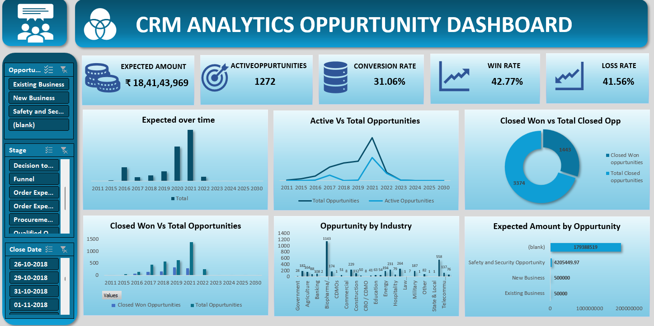
Excel Dashboard

Slide 9
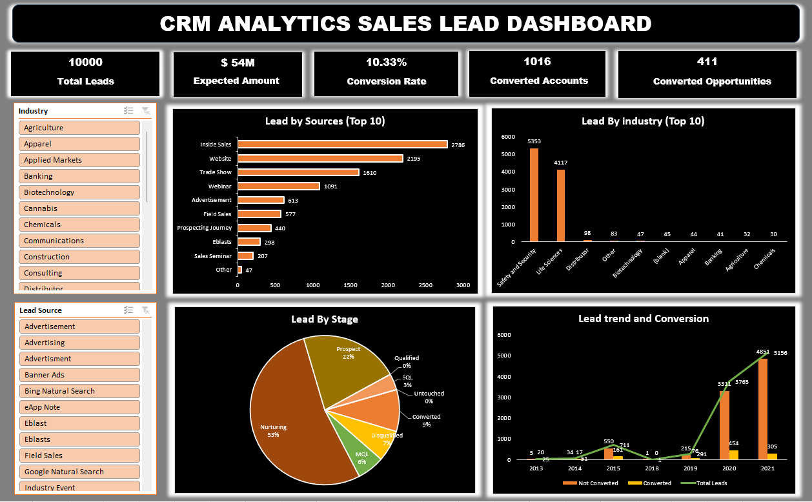
Excel Dashboard

Slide 10
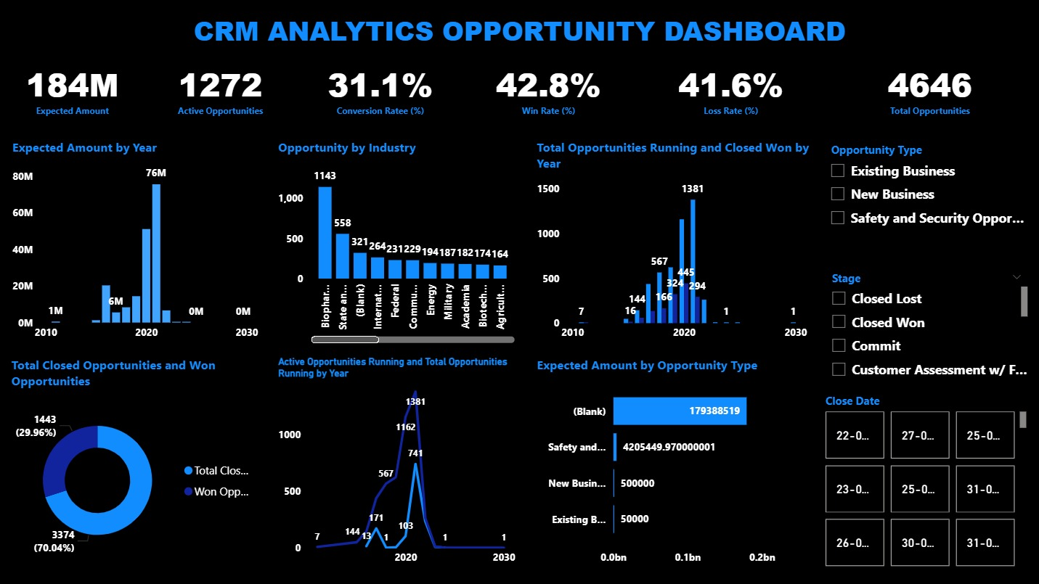
Power BI Dashboard

Slide 11
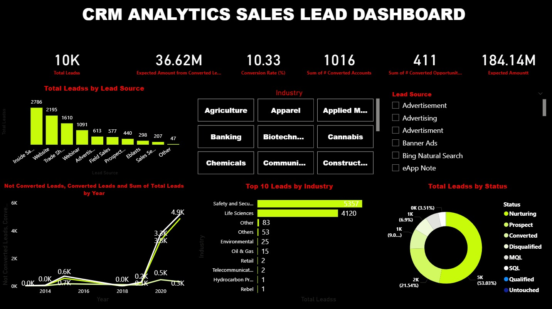
Power BI Dashboard

Slide 12
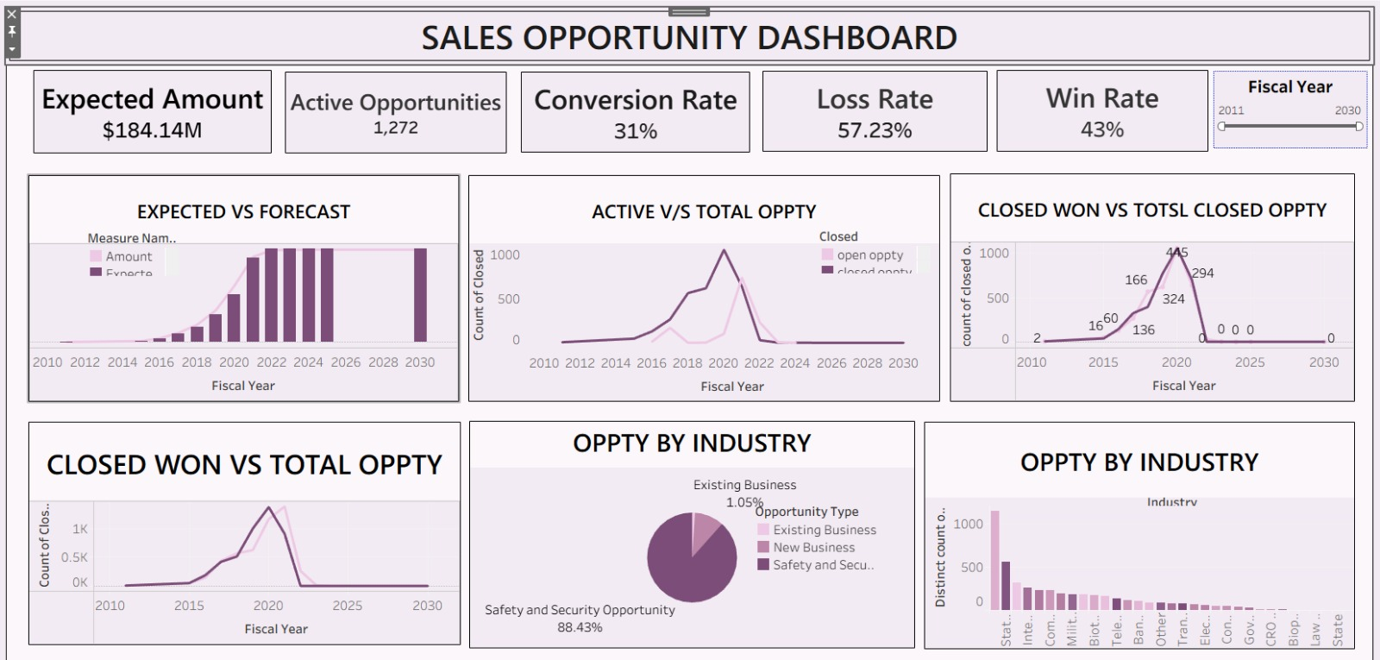
Tableau Dashboard

Slide 13
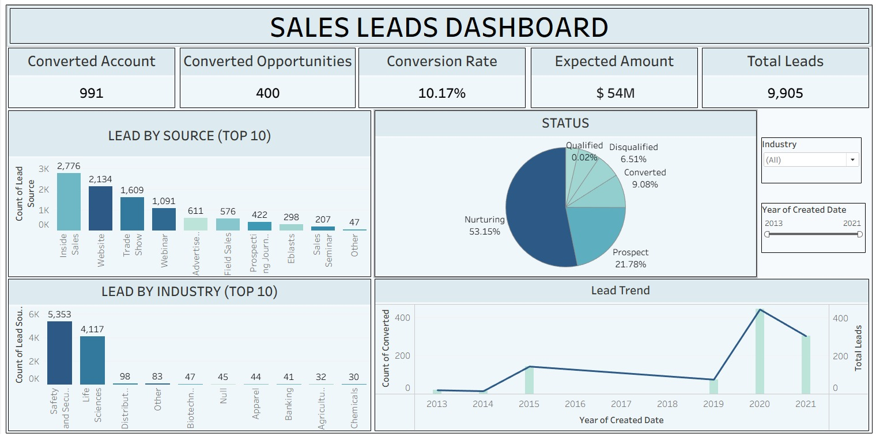
Tableau Dashboard

Slide 14
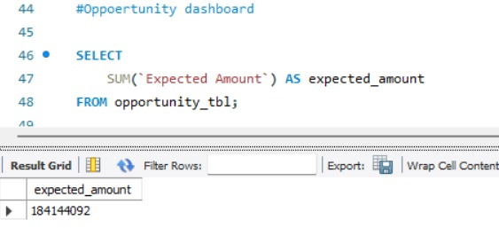
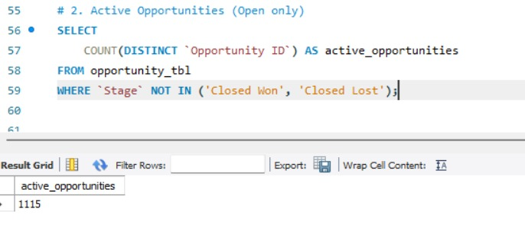
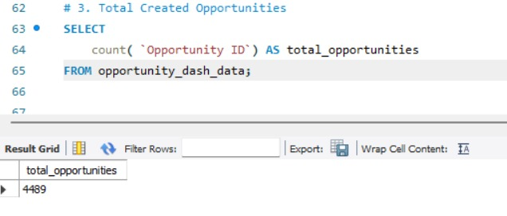
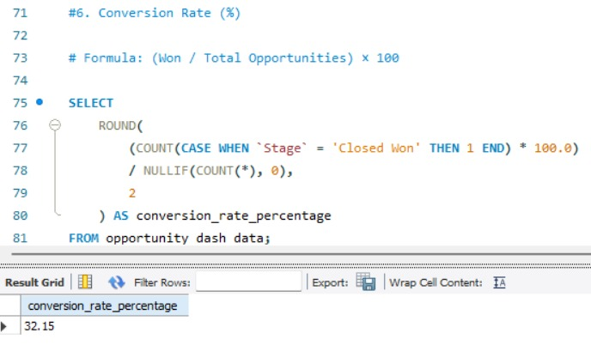
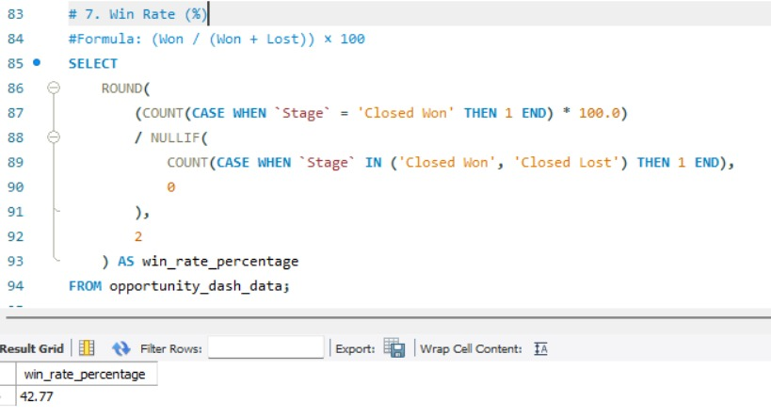
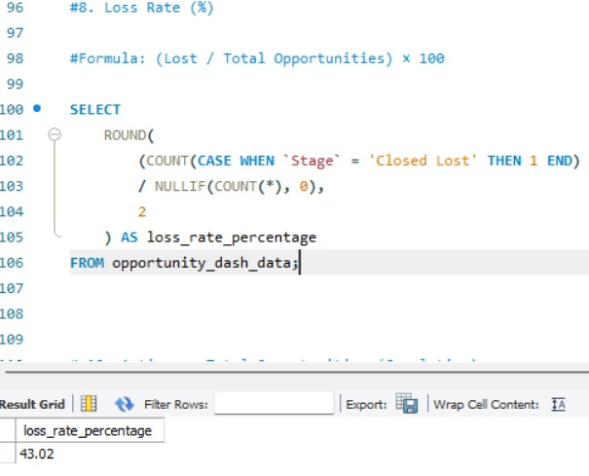
MySQL Queries- Opportunity Dashboard

Slide 15
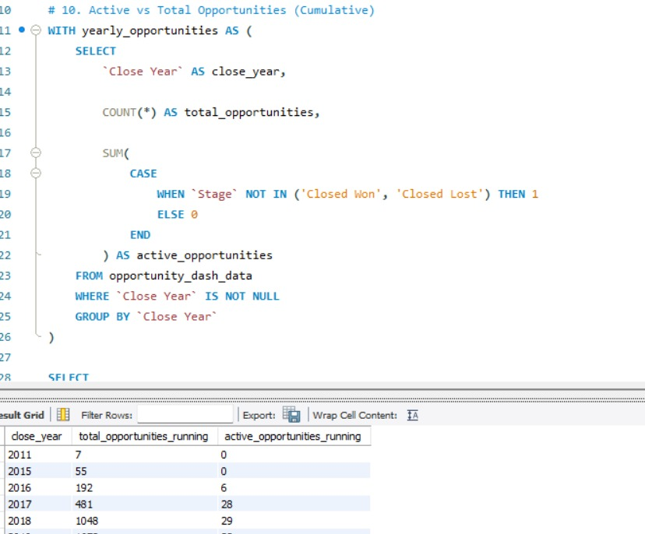
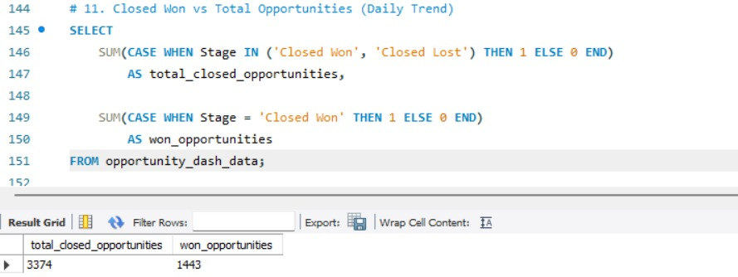
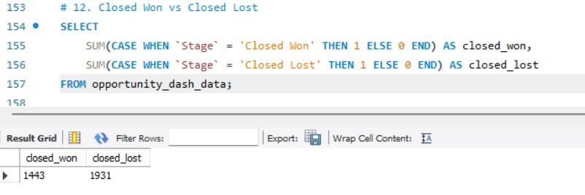
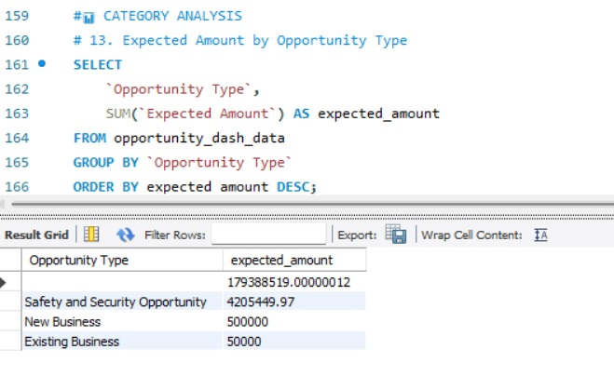
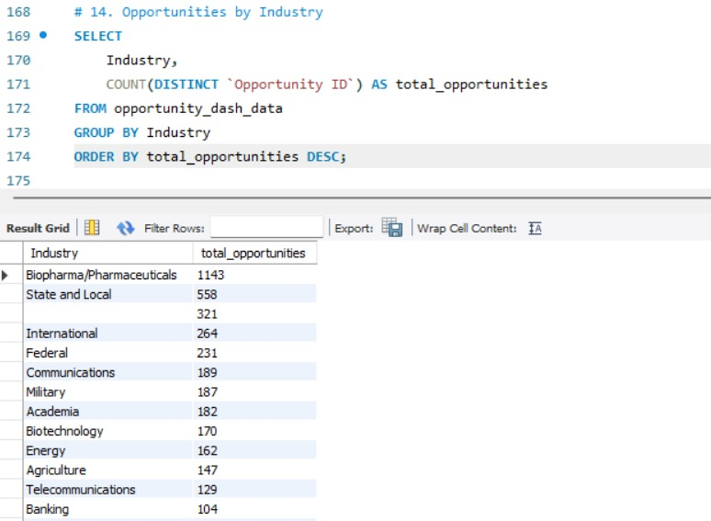

Slide 16
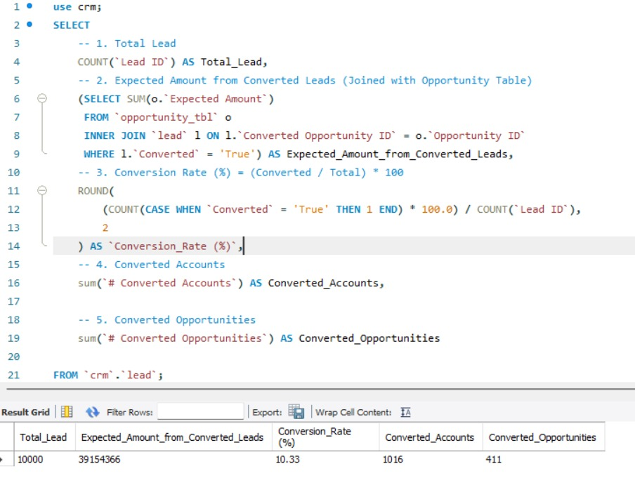
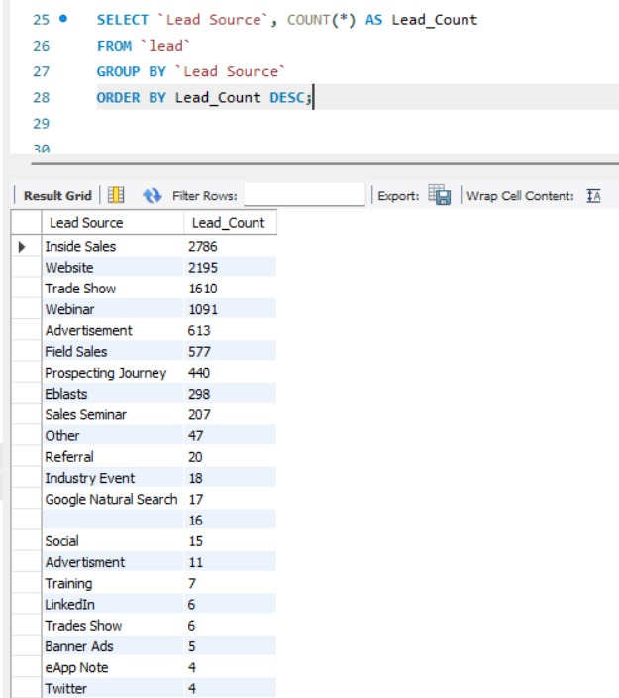
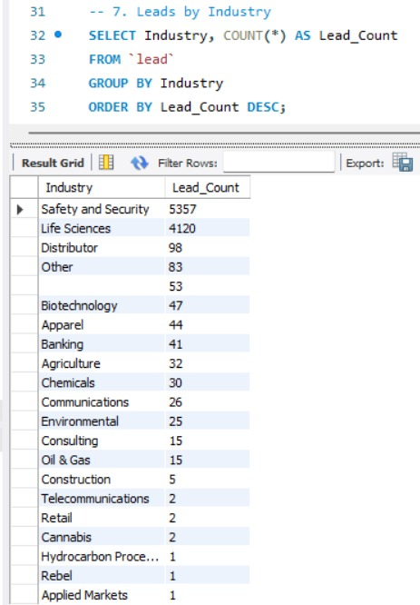
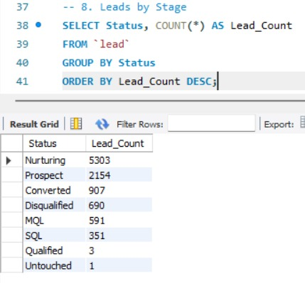
MySQL Queries- Lead Dashboard

Slide 17
Conclusion
Provided an end-to-end view of the sales funnel from Lead generation to Opportunity closure.
Enabled real-time tracking of key KPIs including Expected Revenue, Conversion Rate, Win/Loss Rate, and Active Opportunities.
Identified high-performing industries and lead sources, helping prioritize revenue-driving segments.
Highlighted conversion gaps and pipeline bottlenecks through stage-wise and trend analysis.
Supported accurate revenue forecasting using Expected vs Forecast comparisons.
Empowered sales and marketing teams with actionable insights for data-driven decision-making.
Demonstrated how CRM data can be transformed into meaningful dashboards to improve sales efficiency and business growth.

Slide 18
Focus marketing efforts on high-performing lead sources and industries to maximize conversion efficiency. Implement regular pipeline reviews to reduce opportunity aging and improve closure rates. Strengthen lead nurturing strategies at early stages (Prospect / MQL) to improve overall conversion. Prioritize high-value opportunity types based on Expected Amount trends. Use Win/Loss insights to identify common deal blockers and refine sales strategies. Enhance forecasting accuracy by continuously comparing Expected vs Forecast revenue. Introduce automated alerts for inactive or stalled opportunities to improve follow-ups. Periodically refresh dashboards to ensure real-time visibility and data accuracy.
Recommendation
”

Slide 19

Thank you

